Slide 1
Office 365 Development
Jim Epes, Office Store Sr. Product Marketing Mgr.
Scot Hillier, Office 365 MVP

Slide 2
Embedding Marketing in Your Code
Module 5

Slide 3

Agenda
Think Like a Marketer
Demo: Add License Checks to Your App

Slide 4
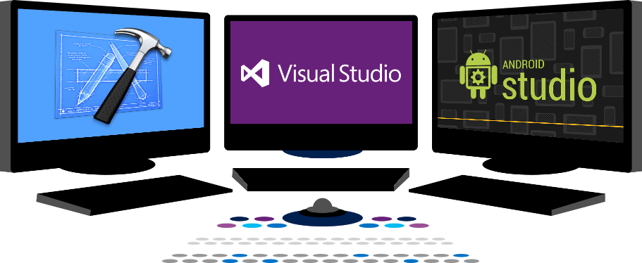














Vision
EXTEND OFFICE EVERYWHERE
CONNECT TO OFFICE 365 SERVICES
BUILD USING AN OPEN PLATFORM
Delve
z
Users and groups
Files
Mail
Calendar
My Apps
Video Portal
Contacts
Office Graph
Presentations
Documents
Spreadsheets
Lync
OneNote
Yammer

Slide 5
Your App: Think Like a Marketer

Slide 6
Your App is your Calling Card to New Customers
Prospects may not know you; your Store listing must reassure & intrigue them
Create a professional, visually appealing and easy to use End to End experience in the Store
Many customers will want to ‘kick the tires’ first
A Free and (especially) a Trial version is key to filling the top of your prospect funnel
For larger developers, direct commerce on the Office Store should not be the only strategy
Many developers have complex licensing models that the Store cannot yet accommodate
Instead, the Store generates leads and developers can close sales on their own commerce sites or via direct engagement
Use Trials to engage and upsell the customer
This module shows you how to do it!

Slide 7
Standing Out in the Store
Professional appearance matters!
Logo, appealing UI, harmonious colors, clear/concise message, localized metadata
Visuals are especially critical
Quality screen shots, links to videos, compliant ads (if any)
Create Trust
Free/Trial versions, Reviews, Contact Info, Privacy Statement, Support statement
Avoid the Bad Stuff (see App Validation list)
Stick to intuitive UI and interaction model
Don’t neglect to design for touch
You’re not done when the App is in the Store
Outbound marketing, partner channel

Slide 8
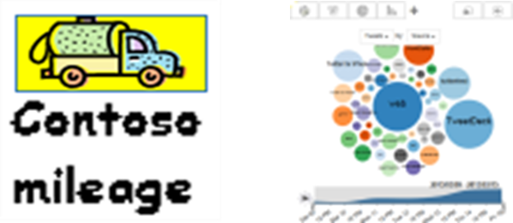
Build a Great Store Listing
Logos: good vs. bad
Pick one that conveys what the app is about
Avoid text-heavy logos – can alias (jagged) in raster files
Appealing and intuitive UI
Balanced visual elements, white space
Leverage the familiar menus, button names & workflow of Office
Incorporate color of the Office application your app works with
Concisely message your value prop
Title CLEARLY states app’s purpose (test w/ strangers!)
Unless you’re a household name, connect your brand to app name
Short Description says why you’re unique & BETTER
Long Description broken into bullets for easier consumption
Quality localized metadata
Have a native speaker help.
Bad: “The Contoso Budget Planner is a free Microsoft Excel Budget Task Pane App”
Better: “A tool for organizing and planning your household budgets”
Best: “Understand and gain control of your household budget in minutes!”

Slide 9
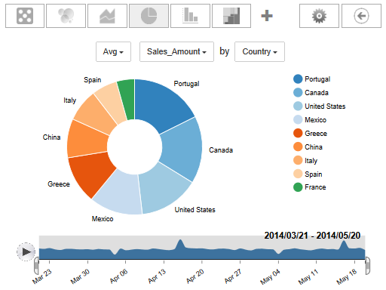
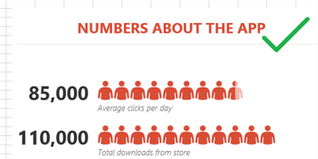
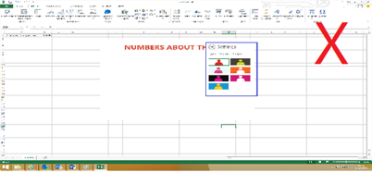
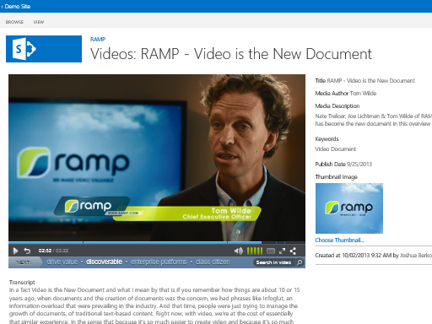
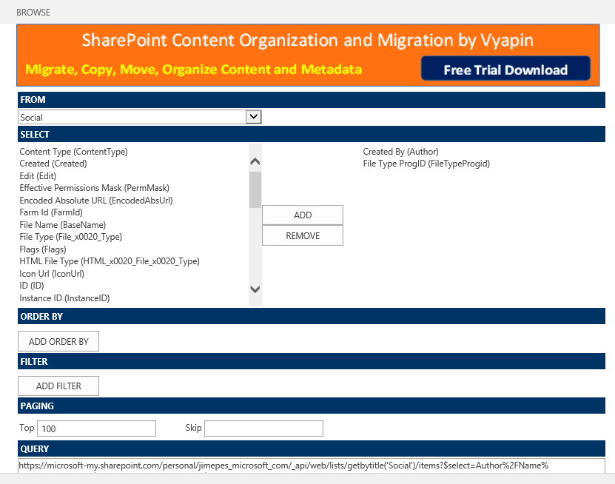
Visuals
Lots of good screen shots!
Highlight core features in your app, not too much of Office
Use compelling sample data to showcase app functions
Crop screenshots of extraneous UI, unrelated taskbars, etc.
Links to videos
Videos dramatically increase connection to apps
Ideally hosted on your site or a branded location elsewhere
Store-compliant ads, if any
Ads cannot dominate app or degrade its performance

Slide 10
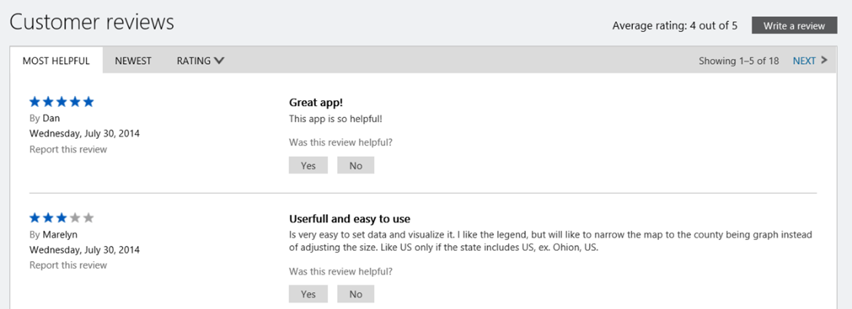
Create Trust
Free / Trial versions
Can dramatically increase downloads and boost ratings
30 – 60 days is a good time frame
Reviews are critical
Recruit reviews if you can – go for legitimacy
Contact info prominently displayed
Make customers confident they can reach you
Remember, every call can be an upsell moment if you have a premium or custom offer
Support Statement
Clear statement of your support terms
Explain all buttons & features on support pages to reduce calls, avoid angry reviews!
Offer good “getting started” advice, especially for more complex apps
Consider a User Forum to encourage community diagnosis, cut down on calls
Privacy Statement
Clear statement on what data you collect & how used; use of cookies & other trackers

Slide 11
Marketing the App: External steps
Easier
Harder
Use free / cheap outreach: email marketing, blogs, social media, community pages
LinkedIn, Twitter, Facebook
Look for ways to encourage viral adoption – free pilots at a few leading customers in exchange for public support
Encourage customers to blog about or review your app in exchange for longer trial
Look for free press coverage (in trade publications, etc.)
Think about the upsell path to a paid / customizable version
Listen closely to reviews and feedback, and improve app in response
Get video testimonials from early customers and feature prominently
Consider a “suite” of apps; market them as a broader solution
Once the user is hooked, consider charging for support
Look for a distributor / reseller if that is feasible

Slide 12
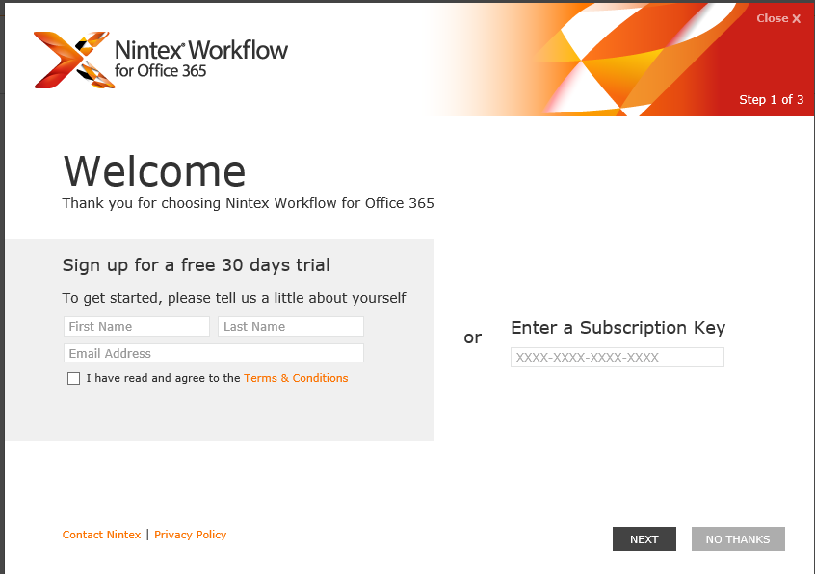
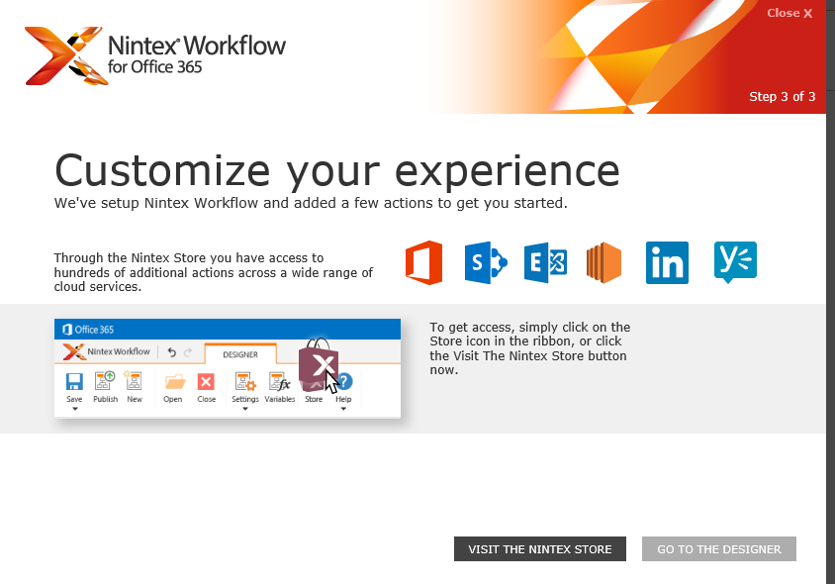
The most powerful marketing of all: In-app
Embed marketing & upsell tools in the app itself
Some of our leading partners have done so themselves – Nintex and Nimble, for example
Now Office team has built a sample app that shows everyone how to do this!
Nintex collects customer contact info at first run, then engages with customer during Trial
Nintex calls out in-app purchase opportunities during signup, and also in the app ribbon itself

Slide 13
demo
Adding license checks to your app

Slide 14
Summary
Think Like a Marketer
Demo: Add license checks to your app

Slide 15



dev.office.com
Sign up
http://dev.office.com/getting-started
Explore
http://apisandbox.msdn.microsoft.com
Get trained http://dev.office.com/training

Slide 16


Feedback
Office 365 Network Share your best practices and join conversations https://www.yammer.com/itpronetwork
Stackoverflow Ask deep technical questions to a world-wide set of developers
http://stackoverflow.com/questions/tagged/ms-office
UserVoice Provide suggestions of what you want in future versions
http://officespdev.uservoice.com/

